Slide 1

Elevate Your Insights Org with C-Suite Level Reporting and Storytelling
Speaker: Anna Lee
July 2025

Slide 2
Legal Disclaimers
The views expressed in this presentation and commentary are solely my own and does not represent or reflect the opinions of Visa Inc or their respective affiliates of employees.
This content should not be taken as any legal or design advice. Please consult a trusted advisor for what’s appropriate for your organization.
Content is intended to be used for informational purposes only.
Past performance is not indicative of future success!

Slide 3

What We Hope To Accomplish Today
How to set up a “story” narrative to keep your audience engaged
1
2
Turn your data-heavy tables into sleek insight-focused content
3
Quick tips to instantly upgrade your PowerPoint Presentation to “WOW”
4
Deliver actionable insights into easy-to-digest formats

Slide 4

How To Tell A Good Story
4

Slide 5
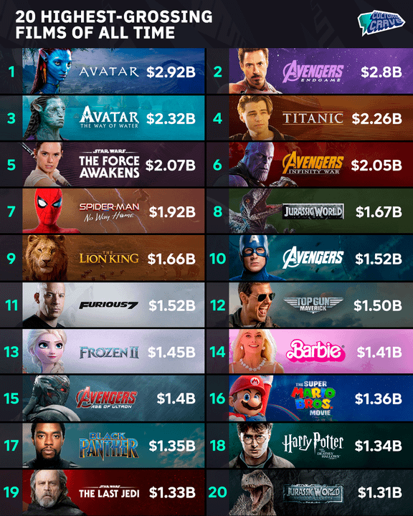
Before you can tell a story, let’s think about the movies, TV shows, or books that were major successes
Key Components Of What Made It “Good”
Good character development with back stories
It had a “good story” with an actual plot, that you can follow along
Imaginative world, with good cinematography
Good “edge of your seat” action/acting, leaving you wanting to know what happens next
Have a good ending (with closure or cliffhanger!)
Source: Reddit r/boxoffice

Slide 6
Leverage Epic Movie Components When Designing Your PowerPoint Deck of Research Data
Successful Movie Components
Research Reporting
Good character development with back stories
It had a “good story” with an actual plot, that you can follow along
Imaginative world, with good cinematography
Good “edge of your seat” action / acting
Have a good ending (with closure or cliffhanger!)
Create a “back story” for your segments (Users vs. Non) (e.g. show attitudes, behaviors, shopping habits)
Have slides follow a logical order (e.g. questionnaire order or make it flow. Connect with purpose.)
Make your slides “pretty” (e.g. optimize the space with good use of colors, graphics, icons, pictures, shapes)
Each slide should have a point (e.g. what’s the 1 (or 2) findings you want them to walk away with)
End with next steps or recommendations on how to move forward (e.g. change their claim? Val prop? Positioning?)

Slide 7


How To Turn Data-Heavy Tables Into Insights
7

Slide 8
Data-heavy tables are a great way to ‘mine’ for the story, but it is not “show ready” when presenting to C-Suite executives
Beliefs Strongly/Somewhat Agree | Gen Z (A) | Young Millennials (B) | Old Millennials (C) | Gen X/Boomers (D)
I prefer credit cards with rewards and perks that never expire as long as I have the card | 95%CD | 96%CD | 90% | 86%
I’d be willing to apply for a new credit card that offers a high sign-up offer | 90%CD | 85%D | 77% | 71%
I choose the credit card that offers the best rewards for my purchases | 90% | 90% | 95%B | 97%AB
I value cash back rewards more than a points system | 90%D | 86%D | 85%D | 78%
I prefer a credit card that offers reward categories of my choice | 72% | 80%ACD | 70% | 66%
I’d be interested in a card that offers rewards for larger purchases | 69%D | 73%D | 77%AD | 60%
I’d be willing to apply for a new credit card that offers discount off future purchase as their sign-up offer | 53%D | 57%D | 55%D | 30%
I’d be willing to pay an annual fee for higher benefits / perks | 35% | 63%AD | 60% | 44%
Questions:
What’s the finding here?
What’s the insight?
Data is fictious and does not represent real research data.

Slide 9
This is what I saw at first glance…
Beliefs | Gen Z | Young Millennials | Old Millennials | Gen X/Boomers
hnwjenvbwhbvwhb | xx%CD | xx%CD | xx% | xx%
I newvnbbw wg | xx%CD | xx%D | xx% | xx%
Vewbewbhwehv w | xx% | 90% | xx%B | xx%AB
Wbewbbfw whbvcv | xx%D | xx%D | xx%D | xx%
Wibehewh v iiooewh | xx% | xx%ACD | xx% | xx%
Bhewhbhew | xx%D | xx%D | xx%AD | xx%
Ehbf v v jebhbwef | xx%D | xx%D | xx%D | xx%
Bebrbhweh vg | xx% | xxAD | xx% | xx%
My Initial Key Takeaway:
Young Millennials are more like than ??? to do Wibehewh v iiooewh, and Bebrbhweh vg …. ?
Data is fictious and does not represent real research data.

Slide 10
4 Key Questions That Help To Focus Your Story, Insights & Actionable Recommendations
Who’s your audience or final user of this deck? (e.g. marketing, product dev, C-suite, insights team)
What was your research trying to solve for? (e.g. business questions/ objectives)
Help To Focus
What were they looking to learn? (e.g. competitive landscape, concept evaluation, positioning, CX)
Are there key user segments they care more about than others? (e.g. Gen Z, Customers, Prospects, Affluent)

Slide 11
Knowing the answers to the top 4 questions will better help you focus on the “right” numbers for your story.
Example:
Audience: Marketing team
Business Objective: how to attract new cardholders / customers to sign up
Looking to Learn: how to craft right marketing campaign for target audience
Key User Segment: Attract more Gen Z and Young Millennial to client base
Beliefs Strongly/Somewhat Agree | Gen Z (A) | Young Millennials (B) | Old Millennials (C) | Gen X/ Boomers (D)
I prefer credit cards with rewards and perks that never expire as long as I have the card | 95%CD | 96%CD | 90% | 86%
I’d be willing to apply for a new credit card that offers a high sign-up offer | 90%CD | 85%D | 77% | 71%
I choose the credit card that offers the best rewards for my purchases | 90% | 90% | 95%B | 97%AB
I value cash back rewards more than a points system | 90%D | 86%D | 85%D | 78%
I prefer a credit card that offers reward categories of my choice | 72% | 80%ACD | 70% | 66%
I’d be interested in a card that offers rewards for larger purchases | 69%D | 73%D | 77%AD | 60%
I’d be willing to apply for a new credit card that offers discount off future purchase as their sign-up offer | 53%D | 57%D | 55%D | 30%
I’d be willing to pay an annual fee for higher benefits / perks | 35% | 63%AD | 60% | 44%
Data is fictious and does not represent real research data.

Slide 12
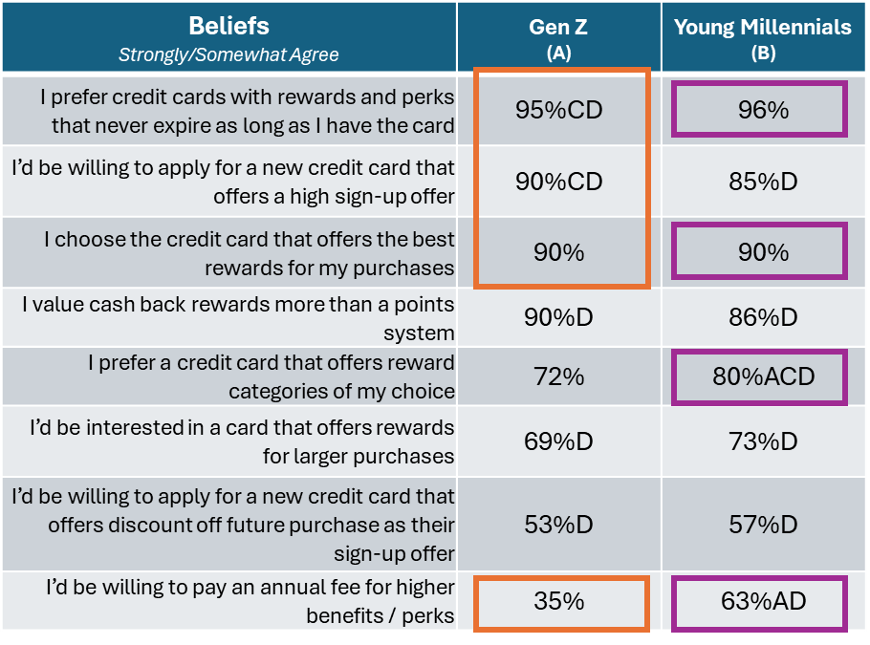
Make mental notes on what the headline would be and what attributes contribute to that takeaway to determine “your” storyline.
Headline:
Gen Zs and Young Millennials are looking for credit cards that offer high sign-up offers, rewards that suit their lifestyle, and never expires.
Gen Zs are less willing to pay an annual fee than their counterparts.
Gen Z
95% prefer rewards that never expire (significantly higher than older)
90% willing to apply for high sign-up offer
90% choose the card with best rewards for purchases
NOT willing to pay an annual fee (35%)
Young Millennials
96% prefer rewards that never expire (significantly higher than older)
90% choose the card with best rewards for purchases
80% prefer cards that rewards categories of choice (significantly higher than older)
MAY BE willing to pay an annual fee (63%)
Data is fictious and does not represent real research data.
Notes:
Why did I pick these specific #s to talk about? There are so many other good data points here?!
Well, I’m the Director of this movie, and this is MY story. Sure, we’ve often questioned, why does the female lead always trip and fall when being chased by a monster? Well, because it adds to the excitement, and this is what I want to happen in MY STORY.

Slide 13

Now How Do We Get To “WOW”?

Slide 14

Let Your Creativity Shine or Google Ideas ! 4 Easy Tips To “WOW” Anyone
1
Use charts, color or pictures to emphasize your point better
2
Use meaningful icons, lines or arrows instead of text where possible
Simplify and declutter slides to create more “white” space
3
Use shapes of all sizes and colors to help “separate” the space
4

Slide 15
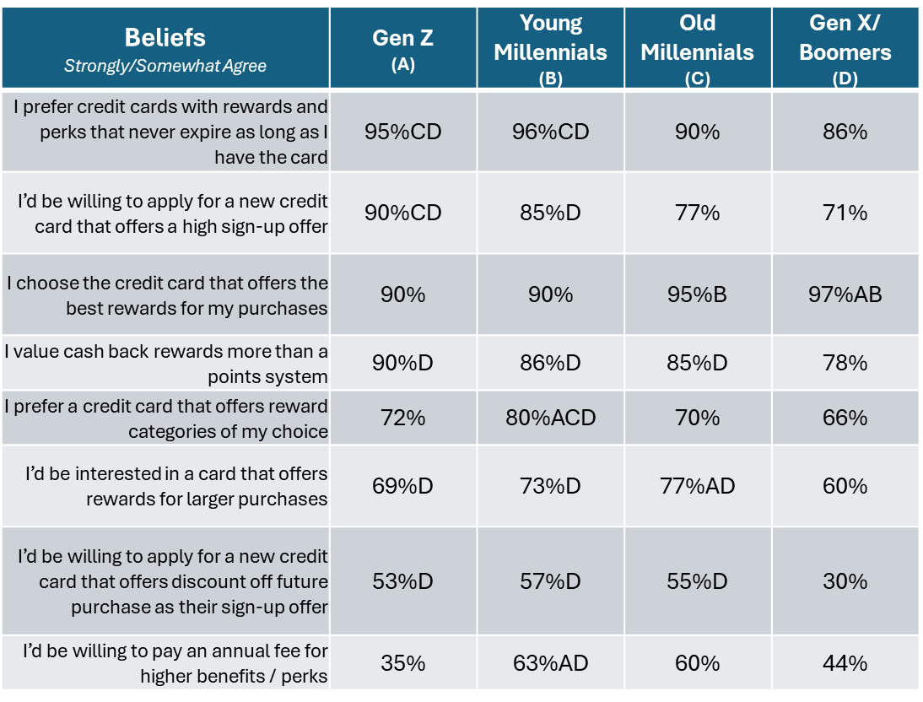
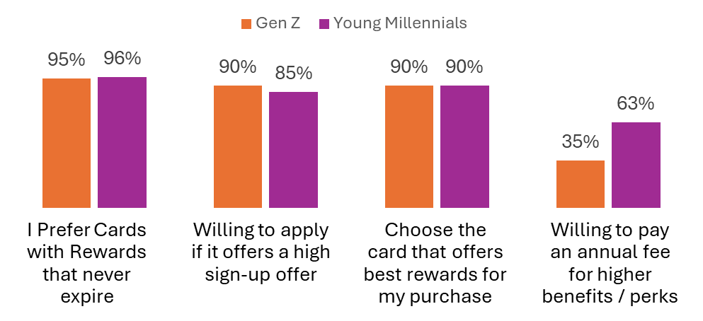
Turn That Table Into An Easy-To-Follow Chart Of ONLY The Supporting Data Points To Keep This High-Level
Headline:
Gen Zs and Young Millennials are looking for credit cards that offer high sign-up offers, rewards that suit their lifestyle, and never expires.
Gen Zs are less willing to pay an annual fee than their counterparts.
Headline:
Gen Zs and Young Millennials are looking for credit cards that offer high sign-up offers, rewards that suit their lifestyle, and never expires.
Gen Zs are less willing to pay an annual fee than their counterparts.
Data is fictious and does not represent real research data.

Slide 16
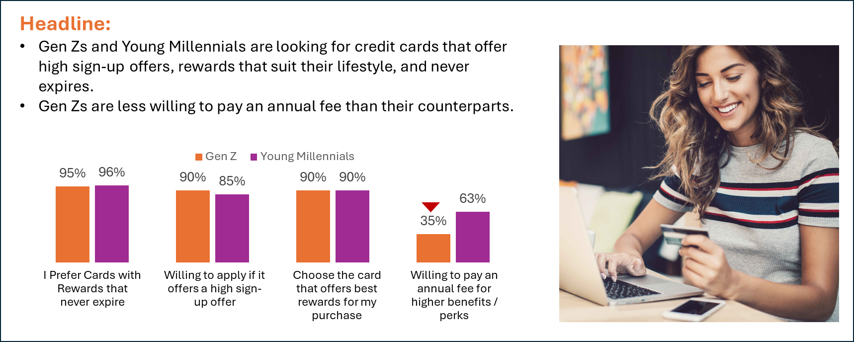
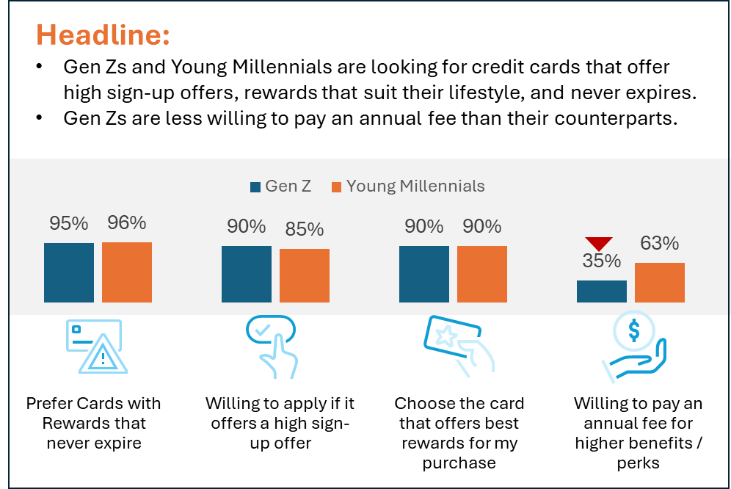
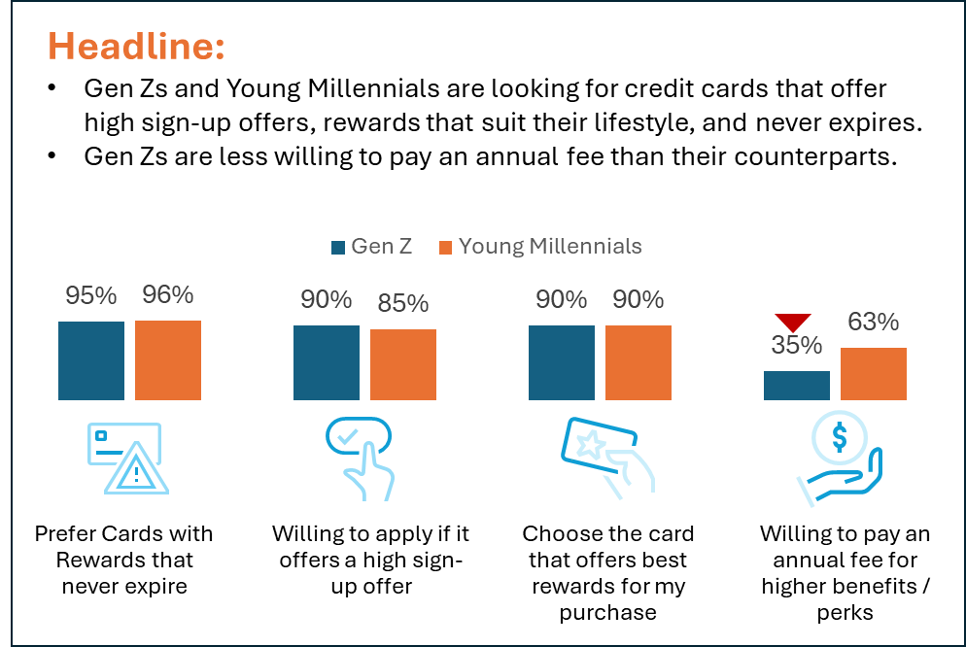
1. Add a picture
Add a picture, icon, or shape to make this slide even more compelling
3. Add a Shape As Background
2. Use Icons
Data is fictious and does not represent real research data.

Slide 17
In A Pinch, You Can Still Turn That Data-Heavy Table Into Something That’s Easier to Follow & Help To Make Your Point More “Sticky”.
Change table shading
Add meaningful borders
Color-code the #s you want them to focus on
Distribute rows so they are “equal” height
Shorten labels and add font color emphasis to keywords
Draw a box around important findings
Credit Card Beliefs & Preferences Strongly/Somewhat Agree | Gen Z (A) | Young Millennials (B) | Old Millennials (C) | Gen X/ Boomers (D)
Prefer rewards / perks that never expire | 95%CD | 96%CD | 90% | 86%
Willing to apply for a new card high sign-up offer | 90%CD | 85%D | 77% | 71%
Choose the card that best rewards for my purchases | 90% | 90% | 95%B | 97%AB
Value cash back rewards more than a points | 90%D | 86%D | 85%D | 78%
Prefer reward categories of my choice | 72% | 80%ACD | 70% | 66%
Interested in rewards for larger purchases | 69%D | 73%D | 77%AD | 60%
Willing to apply for a new card discount off future purchase as sign-up offer | 53%D | 57%D | 55%D | 30%
Willing to pay an annual fee for higher benefits / perks | 35% | 63%AD | 60% | 44%
Blue = Top 3 For Subgroup

Slide 18

Deliver Actionable Insights In Snackable Sizes For C-Suite Execs

Slide 19

Key Tips To Win Over Clients and C-Suite Executives With Your Reports
1
Keep it succinct - figure out ~1-5 pieces of data you want them to walk away with
2
Get to the point in 10 seconds or less (per slide)
3
Keep it simple - don’t “clutter” it with too much text, data numbers or bar charts
4
Make sure it’s actually “actionable” – tell them directly what needs to be done

Slide 20


Gen Zs anticipate traveling more in 2025, and plan to bring at least 2 credit cards with them.
Tips:
Use a relevant hi-res picture
Use meaningful icons
Make #s BIG
Show up to 4 stats
Add shading to key areas to bring it to life
94%
Plan to travel in next 12 months
85%
Anticipate bringing a credit card with them on trip
I always bring at least 2 credit cards when traveling internationally, especially the one with no foreign transaction fees. But I also bring my debit card in case I need to withdraw cash from an ATM.
– Young Millennial, Female
2.4
Average # credit cards will bring on trip
Significant difference between 2025 vs. 2024
Data is fictious and does not represent real research data.

Slide 21
Create up to 5 “buckets” for high-level themes.
Lead with “action” words to make it actionable, and follow with quick facts.
These can be used for coding open-ends, executive summary, or next steps, etc.
Target Gen Zs with High
Sign-up Offers
Emphasize Key Val Prop Of Credit Card
Consider Marketing On Social Media
Drive Awareness To Travel Benefits/ Features
90% of Gen Zs
would sign up for a new credit card with a significant sign-up offer
90% of Young Millennials
prefer cards that offers the best rewards for their purchase
85% of younger audience (age <40) use TikTok, or Instagram
65% indicated they’ve purchased from an influencer
80% worry about their card getting stolen overseas
45% are not aware of Travel Insurance
Data is fictious and does not represent real research data.
21

Slide 22

Open Google.com (or bing.com)
Search for keywords & toggle to “Images”:
Good looking powerpoint slides
Professional powerpoint slide examples
Free powerpoint slide examples
professional powerpoint templates free download
modern professional powerpoint templates
Cheat Codes To Get You Started

Slide 23


FAQs
Great presentation, but when I see large amounts of data, I have no idea where to start?
Remember the 4 key questions to help you focus, determine your key segments, and start turning them all into bar charts, donuts. Any chart is better than a table of numbers.
Where do I find pictures? My company doesn’t provide them.
Google is your new BFF; keyword search anything like: Gen Z shopping, Affluent person smiling, Boomer sailing a boat, modern family shopping at a supermarket.
I did the search for PowerPoint templates, but they cost money and I don’t know how to replicate these?
Pick a design you DO like, and try to re-create them using shapes filled with color, use that as a background, or draw a box and use a thick border line.
Where do I find those neat icons you used in your presentation? My company doesn’t provide them.
PowerPoint offers a huge library of icons. In your menu toggle to “Insert” and select “Icons”
How do I know which 3-4 numbers I should pull into a slide?
Remember the 4 key questions to help you focus. Have a theme you want to draw attention to, and find the #s to support it.
Tip! AFTER you’ve posted all the data into bar charts, write the headline on what the key finding is on the slide.
Based on the # you wrote in headline, now delete all of the other #s on the slide you didn’t write about.
It gets easier with time!
Keep Practicing!

